Slide 1

HEART SHAPED BOX: An Exploration and Harnessing of Data on Cardiovascular Disease (CVD)
Collaborators:
Stephen Milton
Anthony Elbers
Divya Gururajan Sumangala
Brett Wallis
Nalishebo Meebelo
Notes:
Shebo

Slide 2
Project Motivation
To identify relationships of different variables in the context of CVD
Questions:
Risk factors for CVD
Correlations between the variables and CVD?
Percentage between gender and CVD?
Summary of findings:
CVD has a direct correlation between Cholesterol, Blood Pressure, BMI, Physical Activity and Glucose
CVD does not have a direct correlation with Gender
As age advances, prevalence of CVD is more evident
Notes:
Shebo

Slide 3


Questions and Data
Selected medical as area of study from the following interests: Medical, Finance, Health, Sport, NASA
Source a Large Dataset with multiple variables relating to CVD
Open Source Data
Medical Data
Medical Studies
Features of the Dataset – factual, results of med. examination, sourced from patients
CSV file from Kaggle
Surveyed API Data from WHO, ABS, AMA, DMC.
We did not find the data we required
We were unable to interpret the data due to lack of knowledge on medical terminology
Notes:
Shebo

Slide 4
Data Cleanup & Exploration Process
Exploration and cleanup process
3 CSV files downloaded – selected the largest dataset (68783 rows)
Converted CSV using Pandas Dataframe
No null values found in the Dataset
Calculated and created BMI and Blood Pressure Columns
Challenges:
Tried to unite 2 raw Datasets with different headers and observations
Inability to interpret available data from APIs
Insights:
Discovered majority of data contained dichotomous variables
Developed Logistic Regression to establish correlation between variables
Developed Contingency Tables
Developed a Predictive Model
Solutions:
Resolved to use one Dataset due to mismatch in headers and duplicate data
Opted not to include APIs in the project
Notes:
Brett

Slide 5
Data Analysis
Installed the necessary libraries
pandas, matplotlib, scipy, statsmodel, sklearn, numpy, seaborn
Developed relevant Dataframes
Due to binary nature of data, used logit regression to enable further analysis
Developed Contingency Tables and graphs (bar, pie, hist)
Predictive Model
To predict potential risk factors leading to CVD
Notes:
Brett

Slide 6
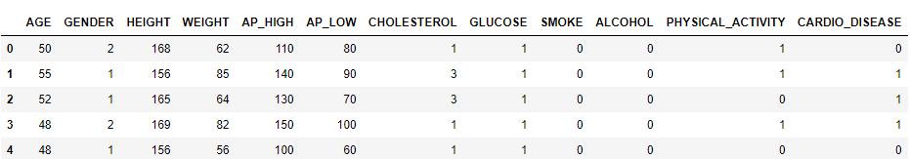
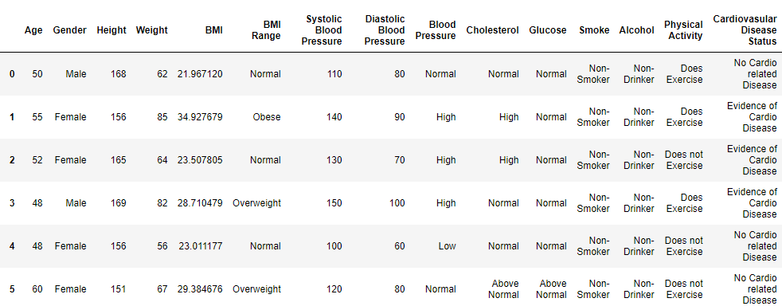
Data Analysis
Original Dataframe
Clean Dataframe
Notes:
Brett

Slide 7
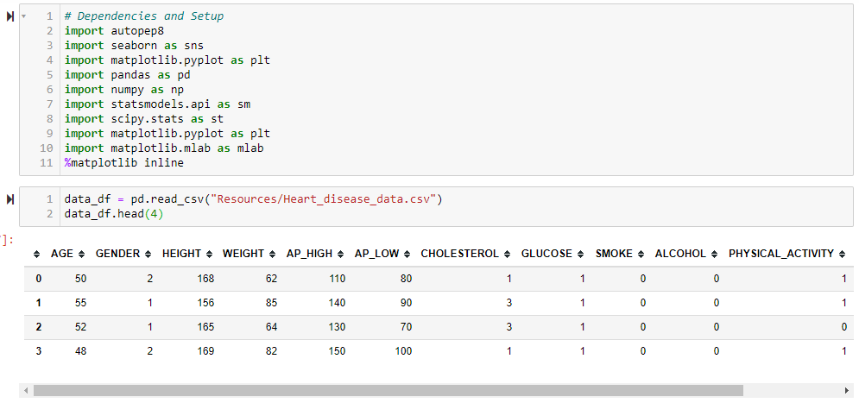

Slide 8
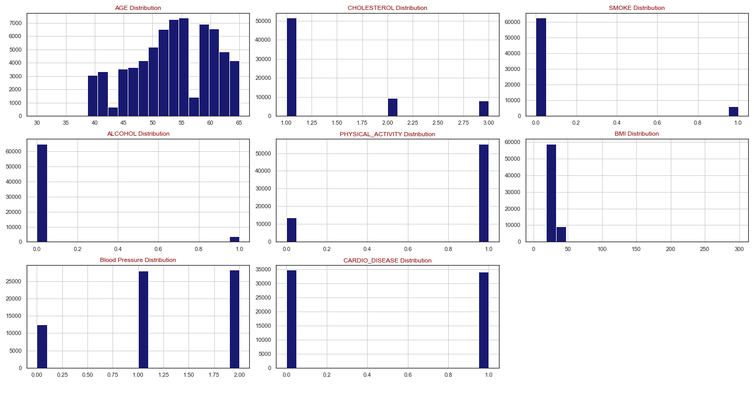
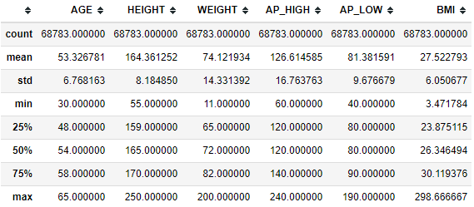
Distribution of Population around Variables
Notes:
Divya

Slide 9
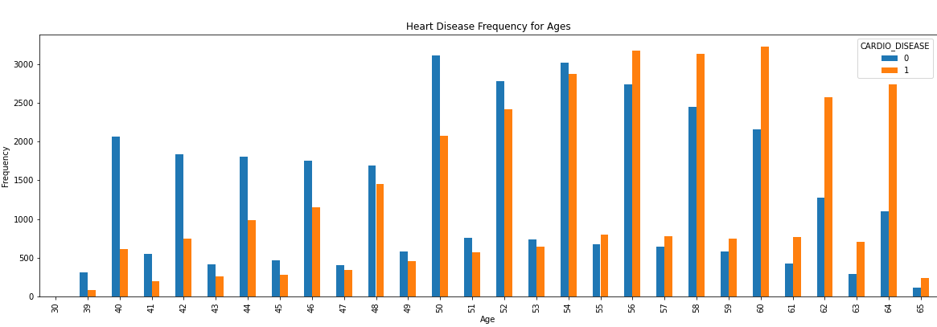
Data Analysis
Notes:
Divya

Slide 10
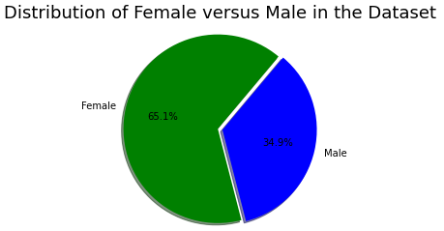
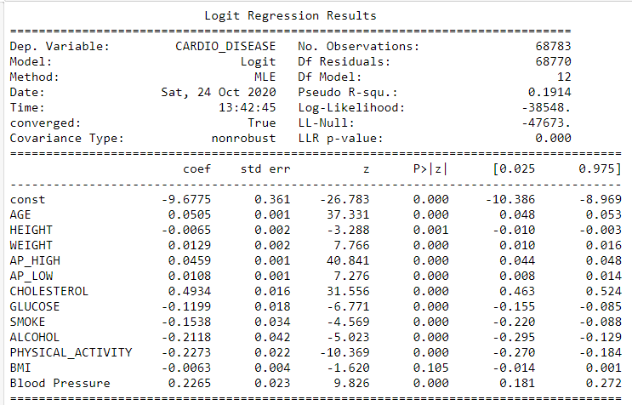
Data Analysis
Table of Logistic Regression
Gender was removed due to noise in the Logistic Regression P value
Notes:
Divya

Slide 11
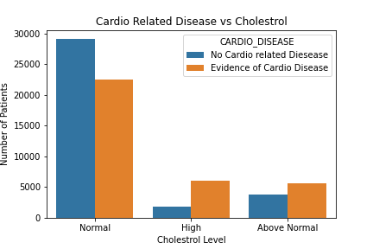
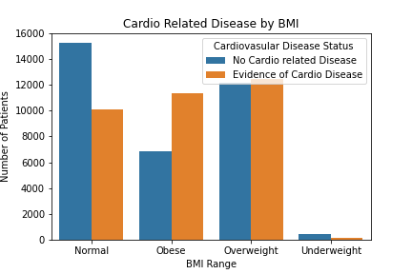
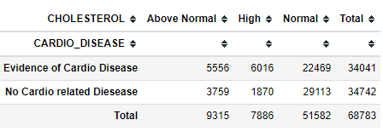
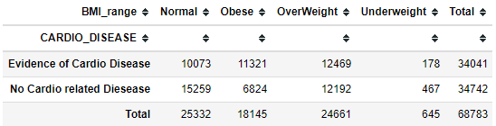
Notes:
Anthony

Slide 12
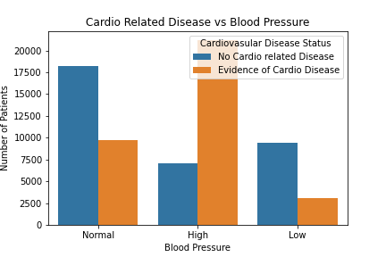
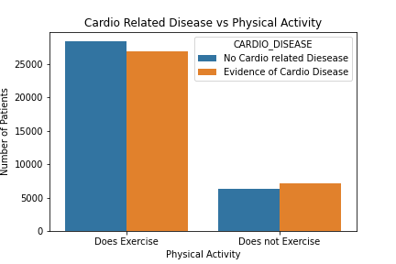
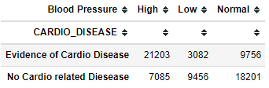
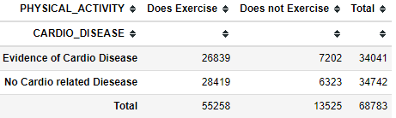
Notes:
Anthony

Slide 13
Post Mortem
Conclusion
In our analysis we found:
Gender is not a contributing factor to CVD
As Age progresses the chance of CVD increases (especially after age 55)
High Cholesterol levels indicate an increased chance of CVD.
Blood Pressure levels above 120 had a direct correlation with CVD.
Patients with a BMI index of Overweight and Obese have a higher chance of CVD.
Patients who exercise are less likely to contract CVD in comparison to those who do not exercise.
Predictive analysis, using logistic regression model we were able to have an accuracy level of 72%
Limitations:
Missing variables contributing to CVD: Nutrition, dietary, location, socio-economic factors.
Unable to present more variety of visualizations due to categorical data.
Notes:
Steve

Slide 14

Questions
Open-floor Q&A with the audience

